Slide 1


Online Clustering: Algorithms, Evaluation, Metrics, Applications and Benchmarking using River
Jacob Montiel, Albert Bifet, Hoang-Anh Ngo, Minh-Huong Le Nguyen
PAKDD 2022 Tutorial

Slide 2


https://sites.google.com/view/pakdd2022tutorial

Slide 3

Outline
Introduction to ML for data streams
Introduction to River
Online clustering algorithms
Online clustering benchmarking with River
https://sites.google.com/view/pakdd2022tutorial

Slide 4

Introduction to ML for data streams

Slide 5


Slide 6


Analytic Standard Approach
Data Set
Classifier Algorithm
builds Model
Model
Finite training sets Static models

Slide 7
ML Standard Approach
Data Stream
Train Model
Train Model
Problem: how often and how much data to use to build the model
Finite training sets Static models

Slide 8
Data Stream Approach
Data Set
Data Set
Data Set
Data Set
Data Set
Data Set
Data Set
Data Set
Data Set
Data Set
Data Set
Data Set
Update
Model
Model
Model
Model
Model
Model
Model
Model
Model
Model
Model
Model
Model
Infinite training sets Dynamic models

Slide 9
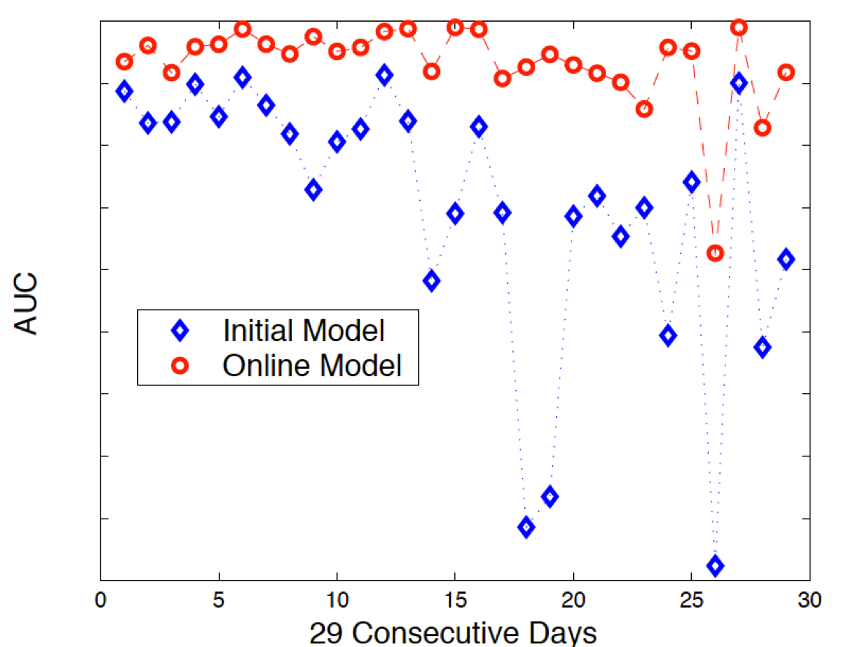
Pain Points
Need to retrain!
Things change over time
How often?
Data unused until next update!
Value of data wasted

Slide 10
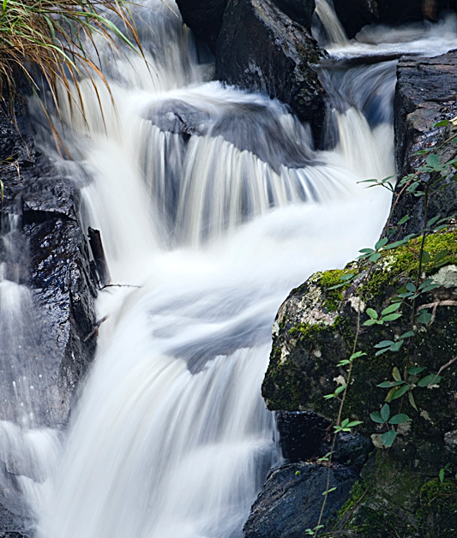
Stream Mining
Maintain models online
Incorporate data on the fly
Unbounded training sets
Resource efficient
Detect changes and adapts
Dynamic models

Slide 11
Approximation Algorithms
General idea, good for streaming algorithms
Small error ε with high probability 1-δ
True hypothesis H, and learned hypothesis Ĥ
Pr[ |H - Ĥ| < ε|H| ] > 1-δ

Slide 12
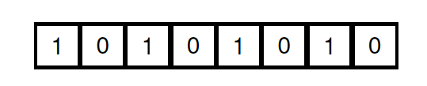
Approximation Algorithms
What is the largest number that we can store in 8 bits?

Slide 13
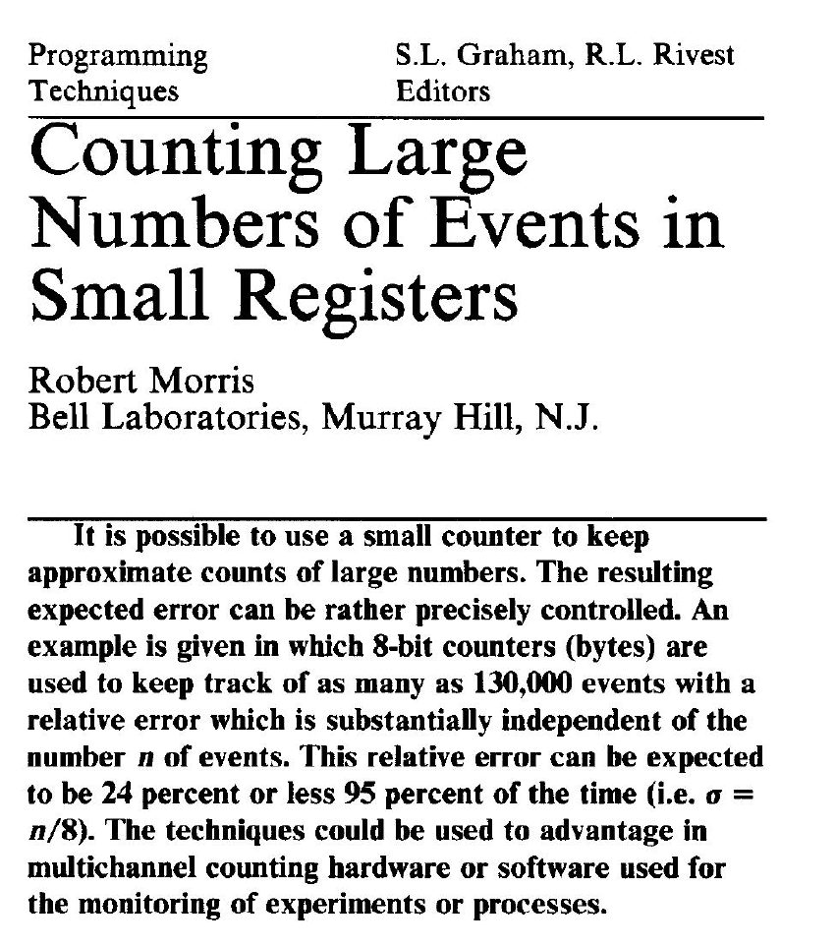
Approximation Algorithms
What is the largest number that we can store in 8 bits?

Slide 14
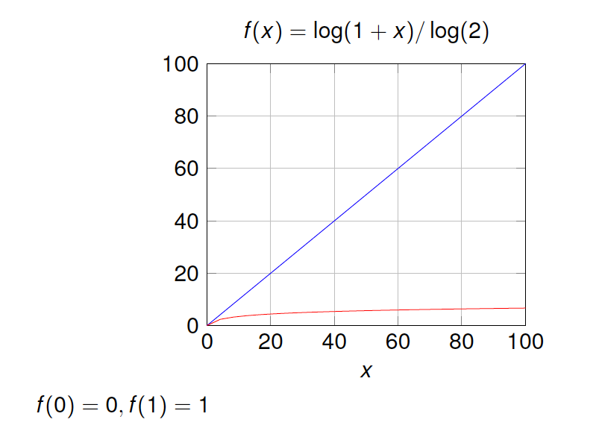
Approximation Algorithms
What is the largest number that we can store in 8 bits?

Slide 15
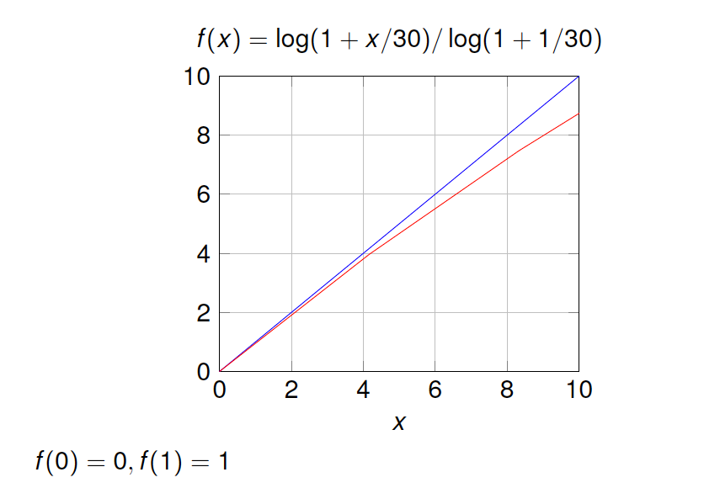
Approximation Algorithms
What is the largest number that we can store in 8 bits?

Slide 16
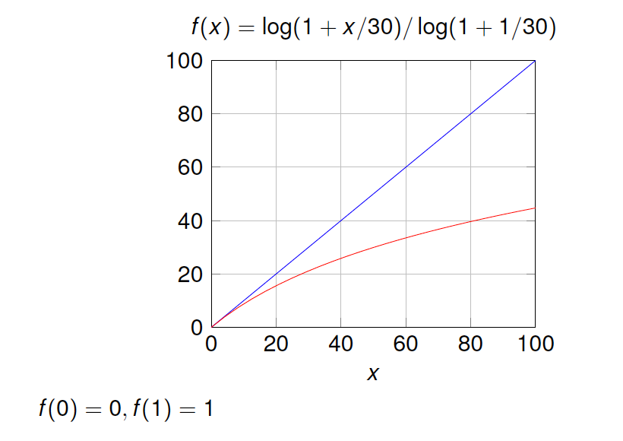
Approximation Algorithms
What is the largest number that we can store in 8 bits?

Slide 17
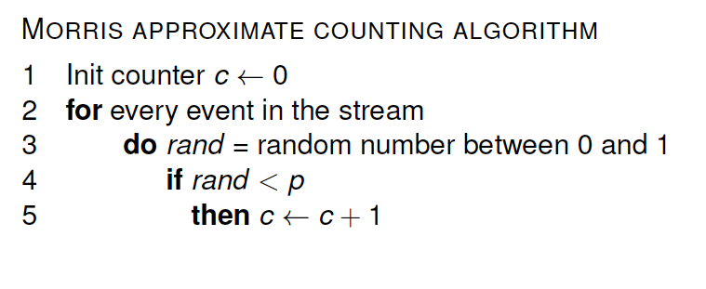
Approximation Algorithms
What is the largest number that we can store in 8 bits?

Slide 18
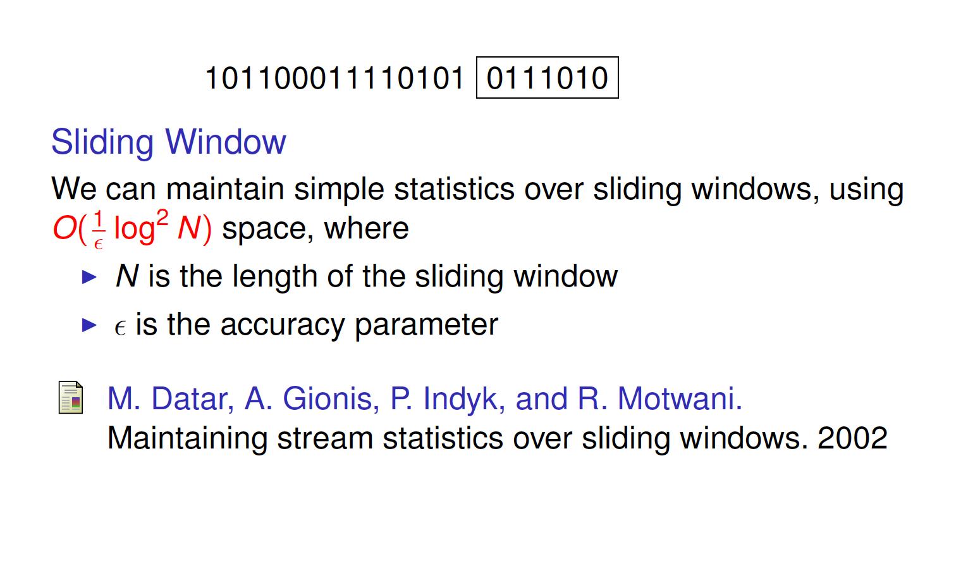
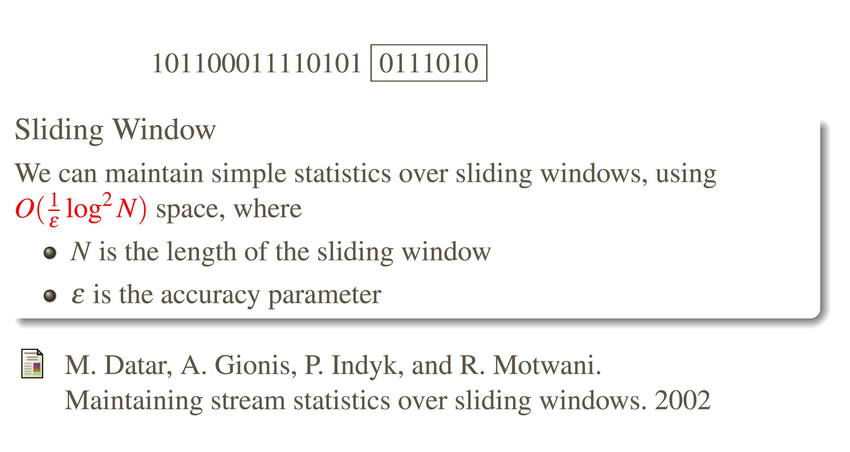
Approximation Algorithms

Slide 19
Classification

Slide 20
Definition
Given a set of training examples belonging to nC different classes, a classifier algorithm builds a model that predicts for every unlabeled instance x the class C to which it belongs
Examples
Email spam filter
Twitter sentiment analyzer
Photo: Stephen Merity http://smerity.com

Slide 21
SAM-kNN
KNN Classifier with Self Adjusting Memory for Heterogeneous Concept Drift.
Viktor Losing, Barbara Hammer, Heiko Wersing:
Best Paper Award ICDM 2016: 291-300

Slide 22
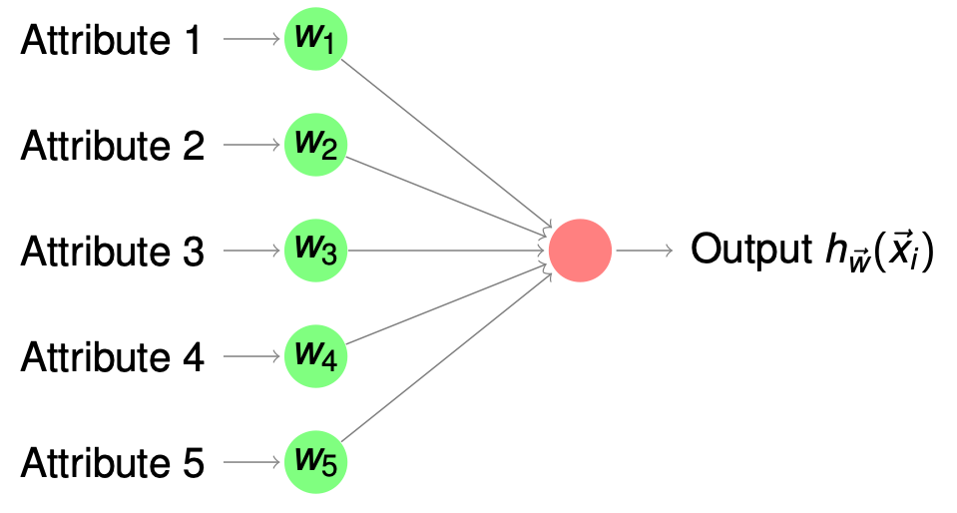
Perceptron
Linear classifier
Data stream: ⟨x⃗i,yi⟩
ỹi = hw⃗(x⃗i) = σ(w⃗i^{T} x⃗i)
σ(x) = 1/(1+e^{-x}) σʹ=σ(x)(1-σ(x))
Minimize MSE J(w⃗)=½∑(yi-ỹi)²
SGD w⃗i+1 = w⃗i - η∇J x⃗i
∇J = -(yi-ỹi)ỹi(1-ỹi)
w⃗i+1 = w⃗i + η(yi-ỹi)ỹi(1-ỹi)x⃗i

Slide 23
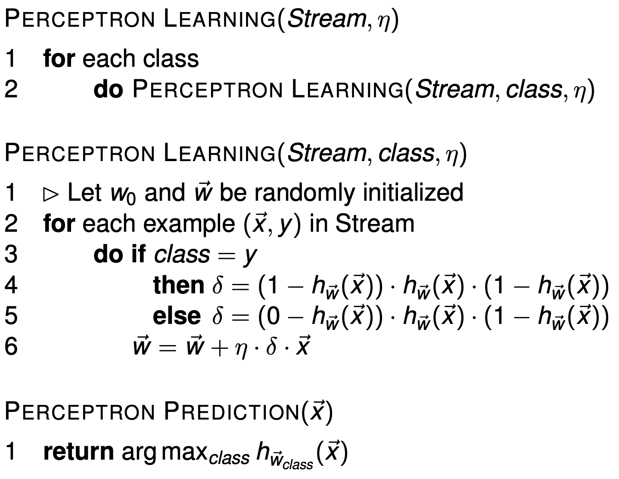
Perceptron Learning

Slide 24
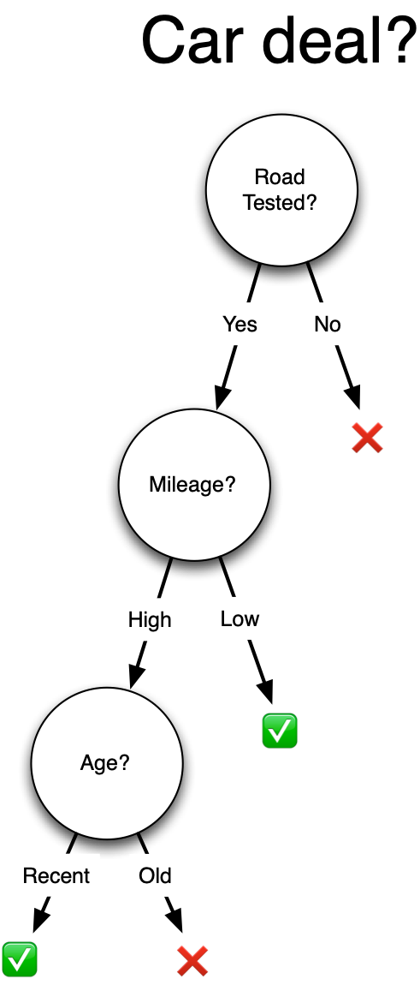
Decision Tree
Each node tests a features
Each branch represents a value
Each leaf assigns a class
Greedy recursive induction
Sort all examples through tree
xi = most discriminative attribute
New node for xi, new branch for each value, leaf assigns majority class
Stop if no error | limit on #instances

Slide 25
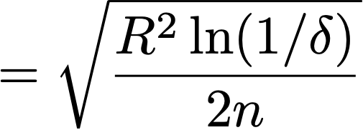
Hoeffding Tree
P. Domingos and G. Hulten, “Mining High-Speed Data Streams,” KDD ’00
Sample of stream enough for near optimal decision
Estimate merit of alternatives from prefix of stream
Choose sample size based on statistical principles
When to expand a leaf?
Let x1 be the most informative attribute, x2 the second most informative one
Hoeffding bound: split if G(x1) - G(x2) > ε
Notes:
Bounded difference from greedy heuristic

Slide 26
Adaptive Random Forest
Why Random Forests?
Off-the-shelf learner
Good learning performance
Adaptive random forests for evolving data stream classification.
Gomes, H M; Bifet, A; Read, J; Barddal, J P; Enembreck, F; Pfahringer, B; Holmes, G; Abdessalem, T.
Machine Learning, Springer, 2017.
Based on the original Random Forest by Breiman

Slide 27
Adaptive Random Forest
Leveraging bagging
Random Hoeffding Trees
random subsets of features for splits
independent (can train in parallel)
Adaptive Learning
1 drift and 1 warning detector per tree
Train trees in the background before adding them

Slide 28
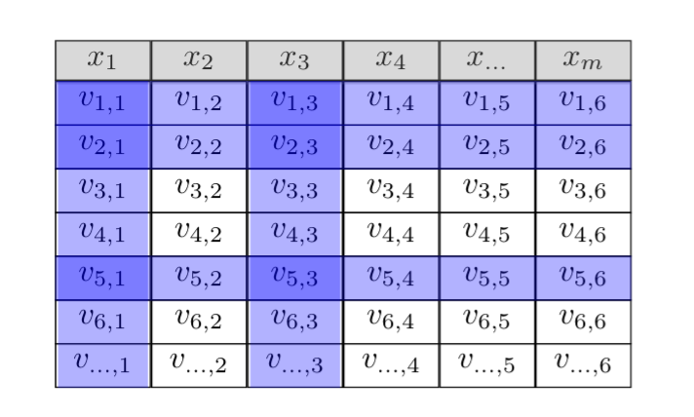
Streaming Random Patches
Streaming Random Patches for Evolving Data Stream Classification
Heitor Murilo Gomes, Albert Bifet, Jesse Read
ICDM, 2019.

Slide 29
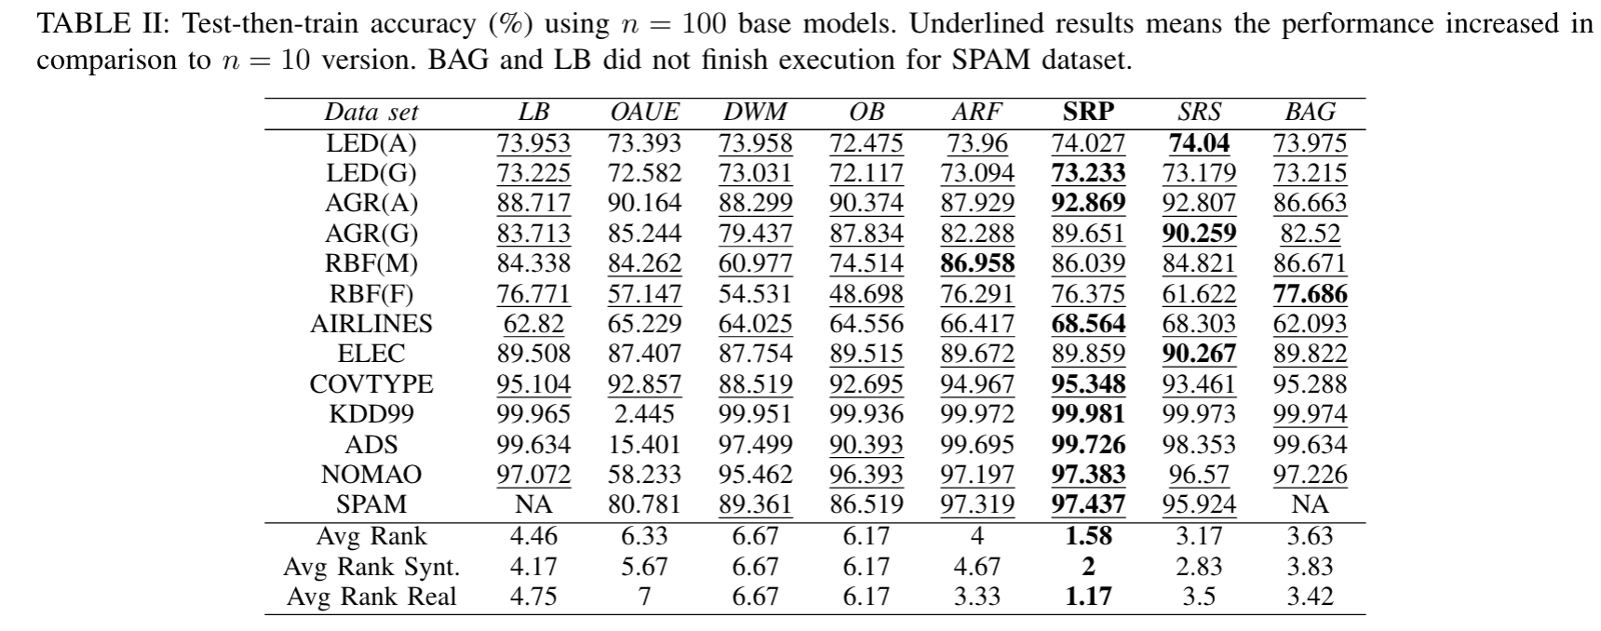
Streaming Random Patches
Streaming Random Patches for Evolving Data Stream Classification
Heitor Murilo Gomes, Albert Bifet, Jesse Read
ICDM, 2019.

Slide 30
Online clustering algorithms

Slide 32

Definition
Given a set of unlabeled instances, distribute them into homogeneous groups according to some common relations or affinities
Examples
Market segmentation
Social network communities
Photo: W. Kandinsky - Several Circles (edited)

Slide 33
Approaches
Distance based (CluStream)
Density based (DenStream)
Kernel based, Coreset based, much more…
Most approaches combine online + offline phase
Formally: minimize cost function over a partitioning of the data

Slide 34
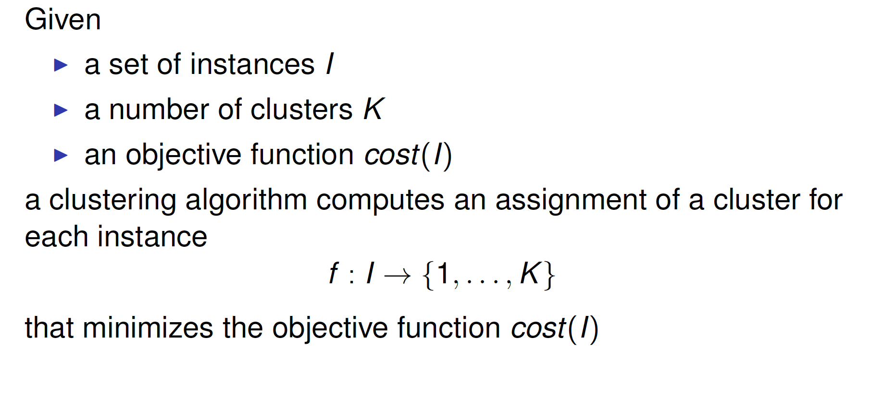
Clustering

Slide 35
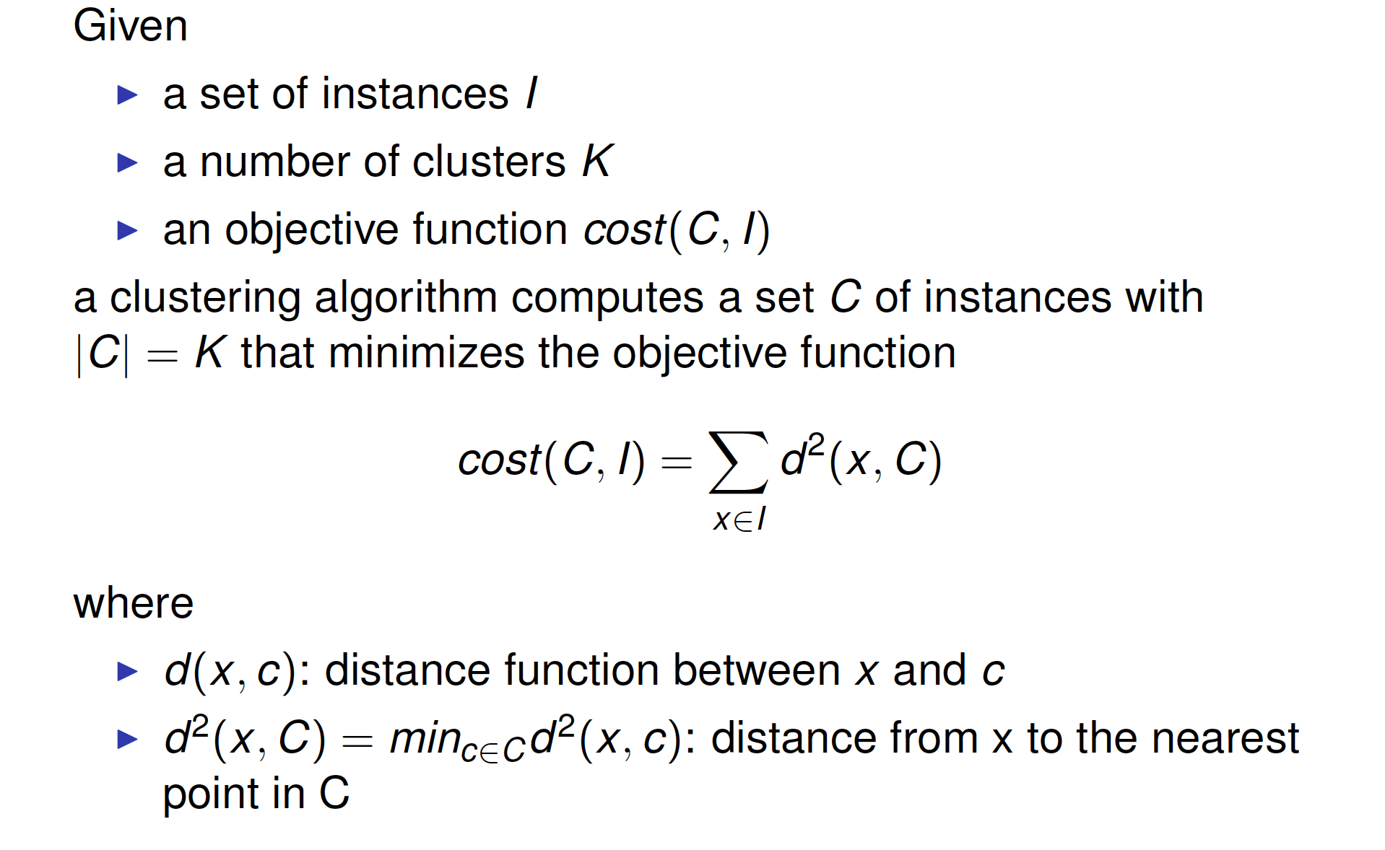
Clustering

Slide 36
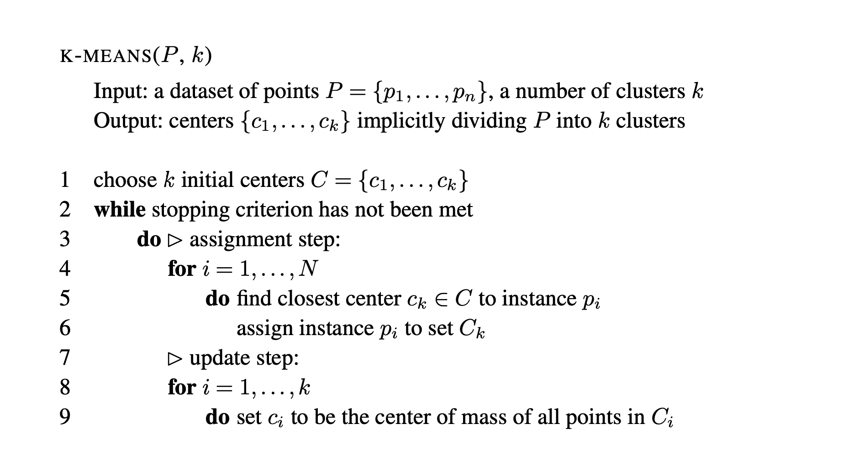
K-Means

Slide 37
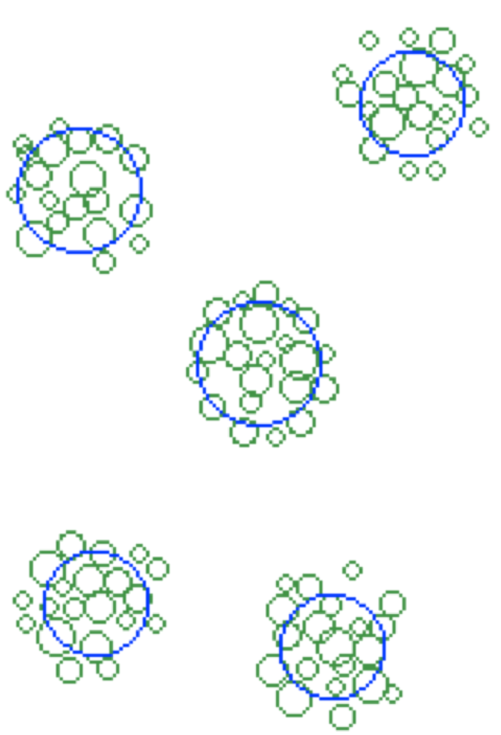
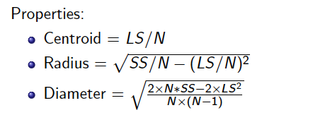
Micro-Clusters
Tian Zhang, Raghu Ramakrishnan, Miron Livny: “BIRCH: An Efficient Data Clustering Method for Very Large Databases”. SIGMOD ’96
AKA, Cluster Features CF Statistical summary structure
Maintained in online phase, input for offline phase
Data stream ⟨x⃗i⟩, d dimensions
Cluster feature vector N: number of points LSj: sum of values (for dim. j) SSj: sum of squared values (for dim. j)
Easy to update, easy to merge
Constant space irrespective to the number of examples!
Notes:
Assignment of point to micro-clusters: if points within boundary (or closest)

Slide 38
CluStream
Charu C. Aggarwal, Jiawei Han, Jianyong Wang, Philip S. Yu: “A Framework for Clustering Evolving Data Streams”. VLDB ‘03
Timestamped data stream ⟨ti, x⃗i⟩, represented in d+1 dimensions
Seed algorithm with q micro-clusters (k-means on initial data)
Online phase. For each new point, either:
Update one micro-cluster (point within maximum boundary)
Create a new micro-cluster (delete/merge other micro-clusters)
Offline phase. Determine k macroclusters on demand:
K-means on micro-clusters (weighted pseudo-points)
Time-horizon queries via pyramidal snapshot mechanism
Notes:
Seeds for offline k-means chosen proportionally to number of points in microcluster
Points are the centroid of the microclusters weighted by their number of points
Time-horizon queries by using a pyramidal snapshot mechanism

Slide 39
DBSCAN
Martin Ester, Hans-Peter Kriegel, Jörg Sander, Xiaowei Xu: “A Density-Based Algorithm for Discovering Clusters in Large Spatial Databases with Noise”. KDD ‘96
ε-n(p) = set of points at distance ≤ ε
Core object q = ε-n(q) has weight ≥ μ
p is directly density-reachable from q
p ∈ ε-n(q) ∧ q is a core object
pn is density-reachable from p1
chain of points p1,…,pn such that pi+1 is directly d-r from pi
Cluster = set of points that are mutually density-connected
Notes:
Non-spherical clusters
Weight µ depends on fading function

Slide 40
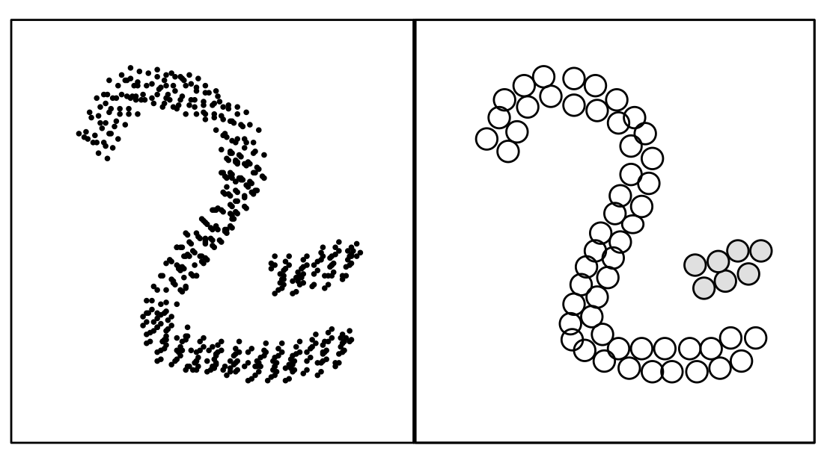
DenStream
Feng Cao, Martin Ester, Weining Qian, Aoying Zhou: “Density-Based Clustering over an Evolving Data Stream with Noise”. SDM ‘06
Based on DBSCAN
Core-micro-cluster: CMC(w,c,r) weight w > μ, center c, radius r < ε
Potential/outlier micro-clusters
Online: merge point into p (or o) micro-cluster if new radius r'< ε
Promote outlier to potential if w > βμ
Else create new o-micro-cluster
Offline: DBSCAN
Notes:
Prune potential to outliers periodically

Slide 41
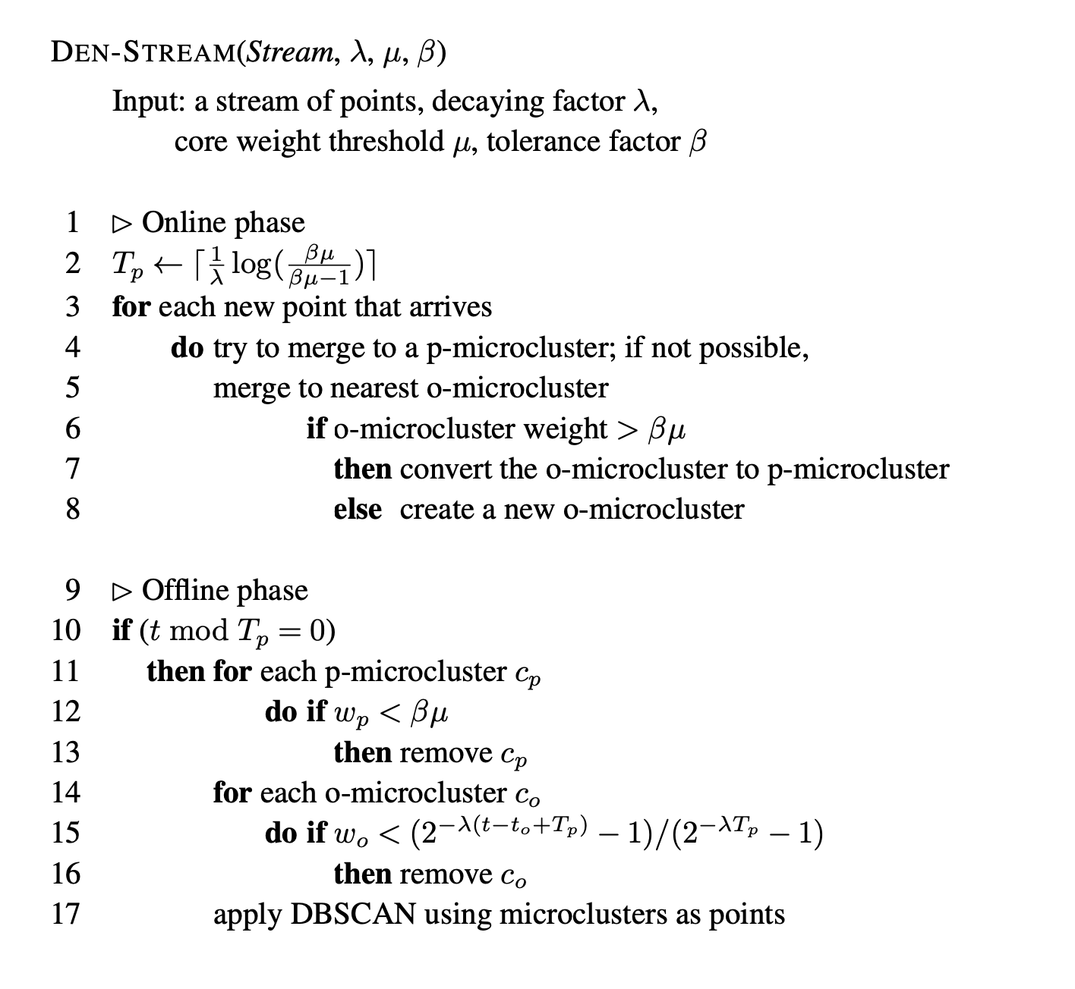
DenStream
Feng Cao, Martin Ester, Weining Qian, Aoying Zhou: “Density-Based Clustering over an Evolving Data Stream with Noise”. SDM ‘06
Notes:
Prune potential to outliers periodically

Slide 42
ClusTree
Philipp Kranen, Ira Assent, Corinna Baldauf, Thomas Seidl:
The ClusTree: indexing micro-clusters for anytime stream mining. Knowl. Inf. Syst. 29(2): 249-272 (2011)
ClusTree: anytime clustering
Hierarchical data structure: logarithmic insertion complexity
Buffer and hitchhiker concept: enable anytime clustering
Exponential decay
Aggregation: for very fast streams
Notes:
Seeds for offline k-means chosen proportionally to number of points in microcluster
Points are the centroid of the microclusters weighted by their number of points
Time-horizon queries by using a pyramidal snapshot mechanism

Slide 43
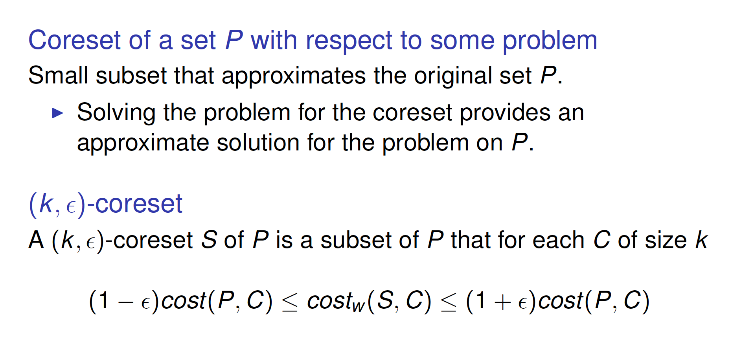
StreamKM++
Marcel R. Ackermann, Marcus Märtens, Christoph Raupach, Kamil Swierkot, Christiane Lammersen, Christian Sohler:
StreamKM++: A clustering algorithm for data streams. ACM J. Exp. Algorithmics 17(1) (2012)
Notes:
Seeds for offline k-means chosen proportionally to number of points in microcluster
Points are the centroid of the microclusters weighted by their number of points
Time-horizon queries by using a pyramidal snapshot mechanism

Slide 44
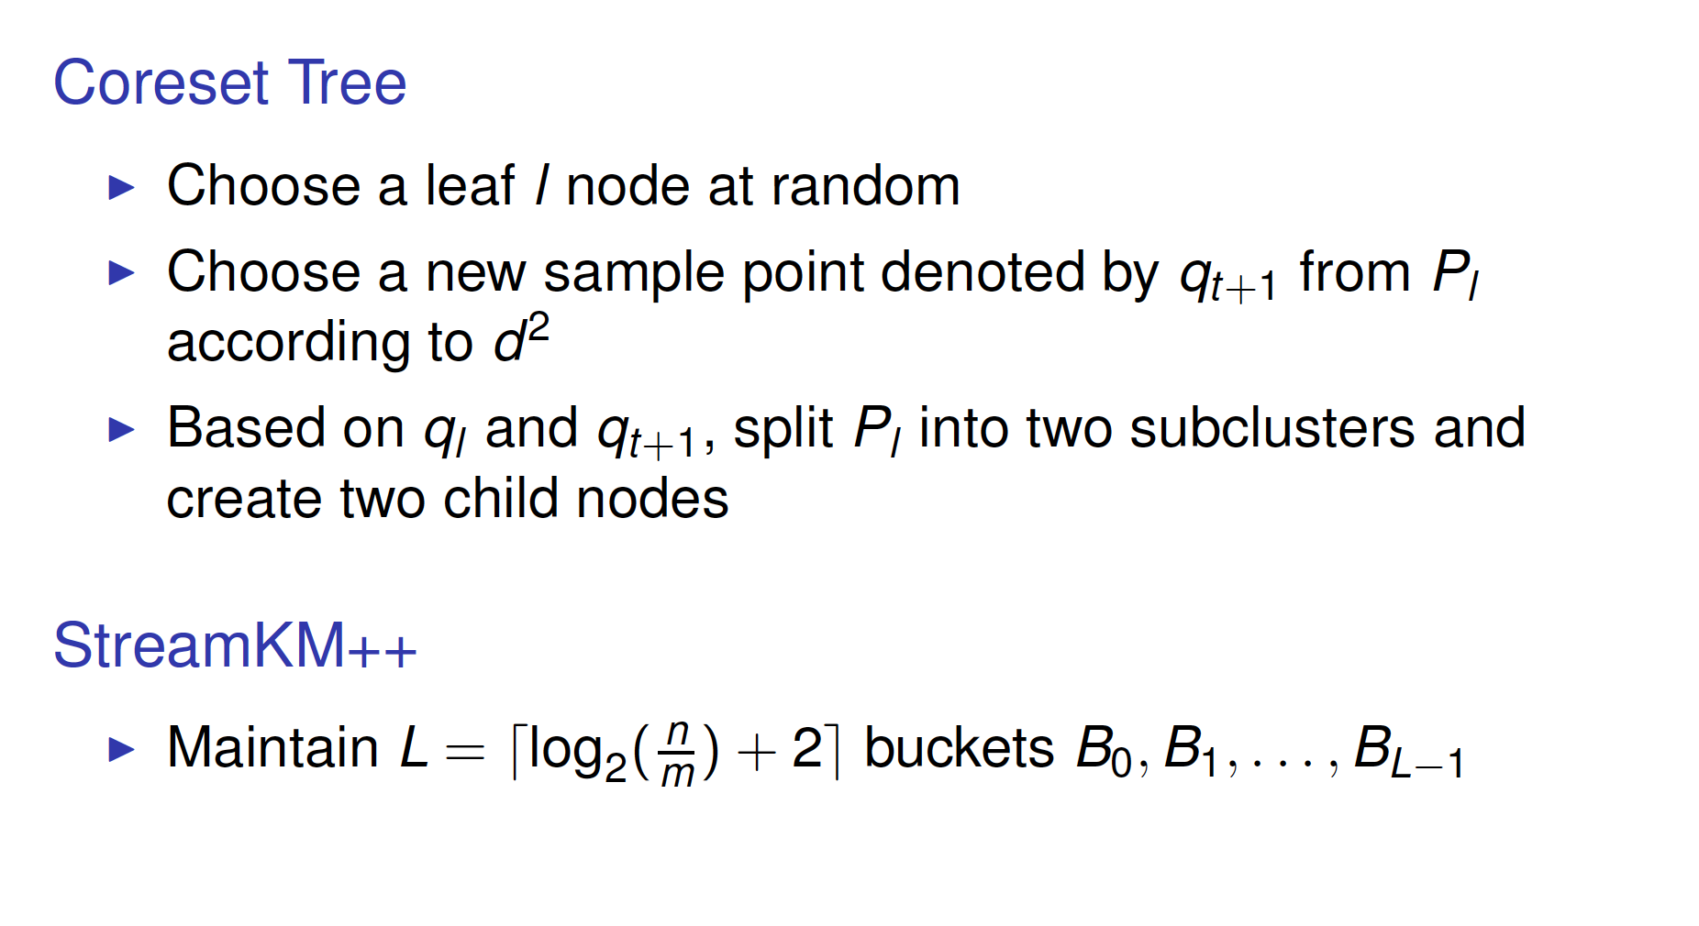
StreamKM++
Marcel R. Ackermann, Marcus Märtens, Christoph Raupach, Kamil Swierkot, Christiane Lammersen, Christian Sohler:
StreamKM++: A clustering algorithm for data streams. ACM J. Exp. Algorithmics 17(1) (2012)
Notes:
Seeds for offline k-means chosen proportionally to number of points in microcluster
Points are the centroid of the microclusters weighted by their number of points
Time-horizon queries by using a pyramidal snapshot mechanism

Slide 45
Static Evaluation
Internal (validation)
Sum of squared distance (point to centroid)
Dunn index (on distance d) D = min(inter-cluster d) / max(intra-cluster d)
External (ground truth)
Rand = #agreements / #choices = 2(TP+TN)/(N(N-1))
Purity = #majority class per cluster / N

Slide 46
Static Evaluation
Internal (validation)
Cohesion: The average distance from a point in the dataset to its assigned cluster centroid. The smaller the better.
SSQ: The sum of squared distances from data points to their assigned cen- troids. Closely related to cohesion. The smaller the better.
Separation: Average distance from a point to the points assigned to other clusters. The larger the better.
Silhouette coefficient: the ratio between cohesion and the average distances from the points to their second-closest centroid.

Slide 47
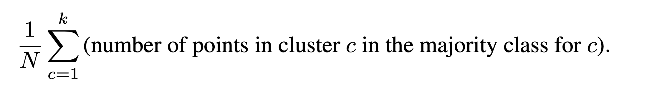
Static Evaluation
External (ground truth)
Accuracy: Fraction of the points assigned to their “correct” cluster.
Recall: Fraction of the points of a cluster that are in fact assigned to it.
Precision: Fraction of the points assigned to a cluster that truly belong to it.
Purity: In a maximally pure clustering, all points in the cluster belong to the same ground-truth class or cluster. Formally, purity is

Slide 48
Streaming Evaluation
H. Kremer, P. Kranen, T. Jansen, T. Seidl, A. Bifet, G. Holmes, B. Pfahringer: “An effective evaluation measure for clustering on evolving data streams”. KDD ’11
Clusters may: appear, fade, move, merge
Missed points (unassigned)
Misplaced points (assigned to different cluster)
Noise
Cluster Mapping Measure CMM
External (ground truth)
Normalized sum of penalties of these errors
Notes:
Evolving clusters have different and changing densities
Normalize by the connectivity of the class/cluster (difficulty of the clustering)

Slide 49

Thanks!
@abifet

Slide 50
Online Clustering: Algorithms, Evaluation, Metrics, Applications and Benchmarking using River
Jacob Montiel, Albert Bifet, Hoang-Anh Ngo, Minh-Huong Le Nguyen
PAKDD 2022 Tutorial

Slide 51
Adaptive Machine Learning for Data Streams
Albert Bifet (@abifet)
Coloquio Nacional en Inteligencia Artificial, 30 June 2021

Slide 52
Thanks!
@abifet

